Slide 1
About me!

Slide 2
First complete these sentences in your exercise book:
My name is…………………...
I’m from……………………….
I live in…………………………
I like……………………………..
I don’t like…………………..
I’ve got…………………………

Slide 3
Let’s read about two famous people and play a memory game!

Slide 4
Let’s check your memory! Do you remember who says what?
Good Luck!!
Click below and do the quiz.
http://www.quia.com/quiz/7652524.html

Slide 5
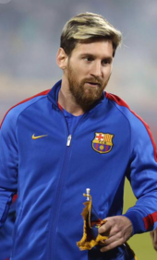
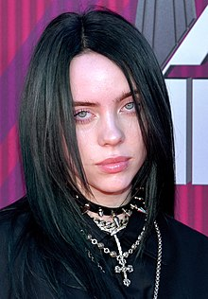
Hi everyone! I am Billie Eilish!
I am 18 years old. I am a singer. I come from the USA. I live in Los Angeles with my family. I like fruit and vegetables. I like animals, too. I’ve got a dog and a cat. What about you?
Hi everyone! I am Lionel Messi! I am 32 years old. I come from Argentina but I live in Barcelona, in Spain. I am a football player. I love football. I like dogs, too. I’ve got a big brown dog.

Slide 6
Listen and complete the following in your exercise book :
Hi! I’m Amara. I’m ……..years old. I’m from……….. I ………. in Kenya with my family. I like fruit. I ……………. mangoes and pineapples. I ………....… bananas. I like animals too. I’ve got a ………… It’s blue, ………….., yellow and …………..

